Slide 1
DSC2207: Data Mining and Wrangling
BSDS 2:2
Topic: Fundamentals of Big Data
Department of Computing & Technology
Faculty of Engineering, Design & Technology
Fri 6th Sept 2024

Slide 2

COURSE OVERVIEW
Big Data
Fundamentals and Mining
Data Analytics
Architectures, storage of data
Data Mining Techniques
Descriptive analytics
Predictive analytics
Notes:
Limited empirical investigation into the challenges encountered by Master's degree students
during the dissertation writing process contributes to difficulties in completing dissertations, resulting in elevated dropout rates and delayed program completion. This study seeks to fill this research gap by examining the specific challenges and solutions.

Slide 3
Lecture Objectives and Learning outcomes
The Objectives of this lecture are :
Understand the characteristics, challenges, and opportunities of big data
Learn about the big data architectures
Learn about big data storage and management.
Understand the principles of data pre-processing.
By the end of this lecture, students should be able to:
Have an understanding of the applications of big data.
Use python libraries to manage and pre-process big data.

Slide 4
Lecture Overview
Exploratory Data Analysis
Descriptive Statistics
Definition and identifying outliers
Handing of outliers
Hands-on practical

Slide 5
Understanding big data management
Qn. Describe data flow through pipelines
The data pipeline starts with data being extracted, transformed and loaded for storage either on cloud or on-premises storage.
Data flows through the three phases of a data pipeline; ingestion(Extract), transformation and storage(load).

Slide 6
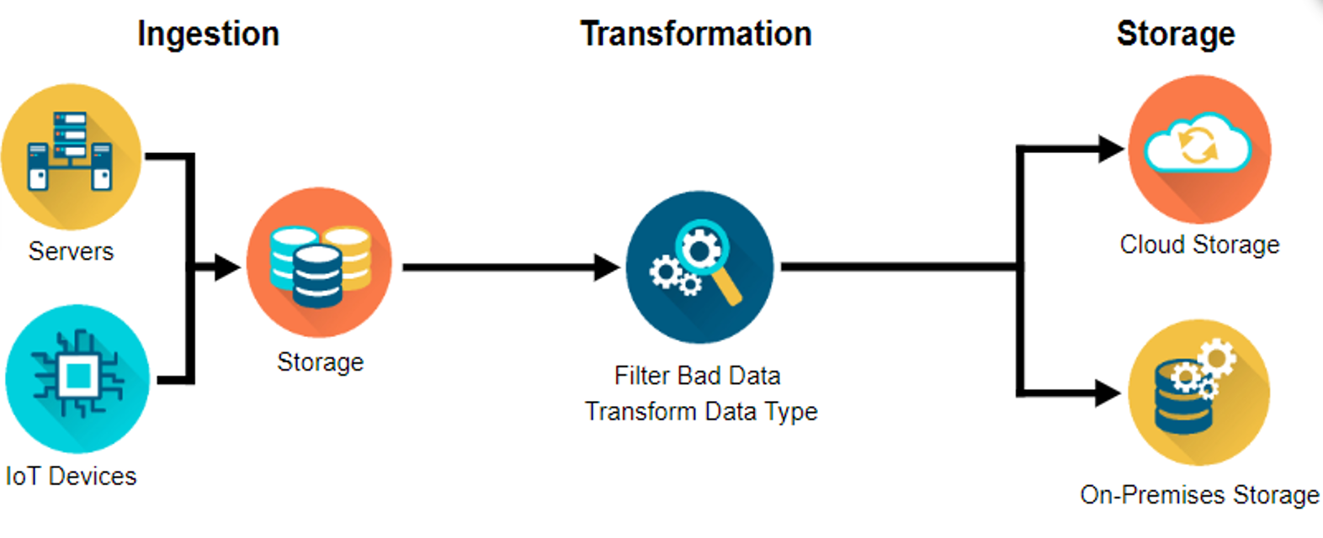
Understanding big data management

Slide 7
Ingestion (Extraction)
Data engineers ingest two primary sources of data;
1. Batches of data from servers or databases (batch ingestion).
An example of batch ingestion is a game company that wants to examine the relationship between subscription renewals and customer support tickets. It could ingest all the related data on a daily or weekly basis. It doesn’t need to access and analyze data immediately after a support ticket is closed or a subscription is renewed.

Slide 8
Ingestion (Extraction)
2. Real-time events happening in the world and streaming from the world of devices (streaming ingestion).
An example of streaming ingestion is when you request a ride from a ride share service. The company combines streams of data (e.g. historical data, real-time traffic data, and location tracking) to make sure you get a ride from the driver who is closest to you at the time.

Slide 9
Transformation
There are two main issues to deal with here;
Data often needs to be cleaned up.
Missing values, dates can be in the wrong format and data quickly gets outdated.
You might have gathered data on individuals who have changed roles or companies. So, all this data needs to be updated.
There might be data outliers that need to be handled as well

Slide 10
Transformation
2. Transforming the data so that its structure aligns with the system needed to allow accurate analyses.
For example;
You might want to figure out your company’s best selling products every month. But the data may only contain each product’s sale date. You would need to transform the data by creating a number of sales per month variable or total monthly sales.

Slide 11
Loading
After transforming data, it needs to be stored in places and forms, making it easy for analysts to run reports on weekly sales and data scientists to deduce insights and create predictive recommendation models.
Data security, or managing data access so that people who should be accessing the data can efficiently, and keeping out people who shouldn’t.
There are two primary locations for businesses to store their data;
1. On-premises
2. In the cloud but often, companies use a hybrid of both.
The term “on-premises” refers to hardware on an organization’s servers and infrastructure - usually physically on site.

Slide 12
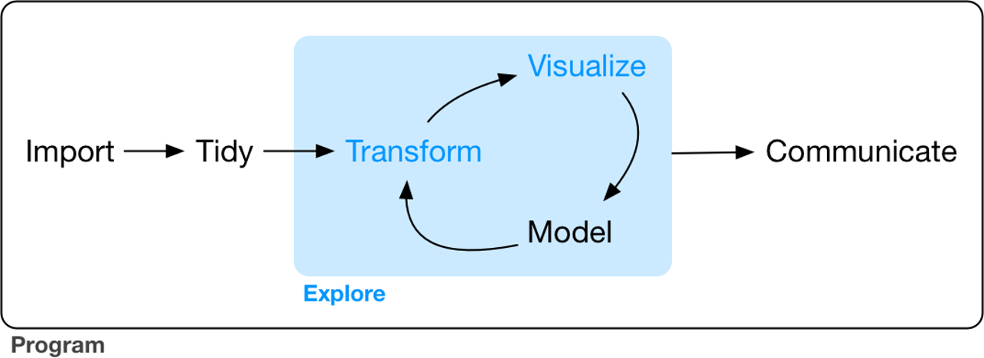
Steps of data exploration
Data exploration is the art of looking at your data, rapidly generating hypotheses, quickly testing them, then repeating again and again and again.

Slide 13
Exploratory Data Analysis (EDA)
An interactive cycle;
1. Generates questions about your data.
2. Searches for answers by visualizing, transforming, and modeling your data.
3. Uses what you learn to refine your questions and/or generate new questions.
There is no rule about which questions you should ask to guide your research.
However, two types of questions will always be useful for making discoveries within your data. You can loosely word these questions as:
1. What type of variation occurs within my variables? (i.e. variability)
2. What type of covariation occurs between my variables? (i.e. central tendency)
All of the above questions generate DESCRIPTIVE and NOT predictive analyses

Slide 14
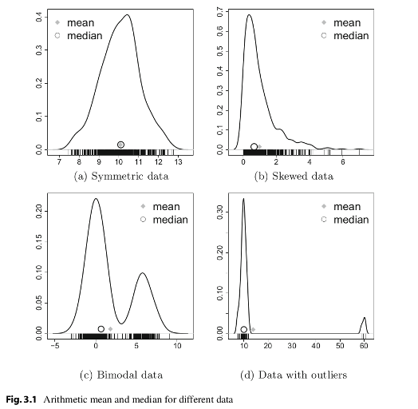
Central tendency
Central tendency is a measure that best summarizes the data and is a measure that is related to the center of the data set.
Described by the statistics Mode, Median and Mean

Slide 15
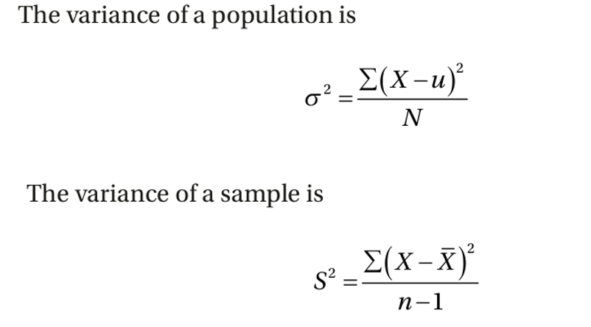
Variability
Measures of variability are the measures of the spread/dispersion of the data.
Described by range, interquartile range, variance, standard deviation, and more
Variance is one of the most important measures in statistics
Covariation- two or more variables vary in a related manner. The best way to discover covariation is to visualize the relation.

Slide 16
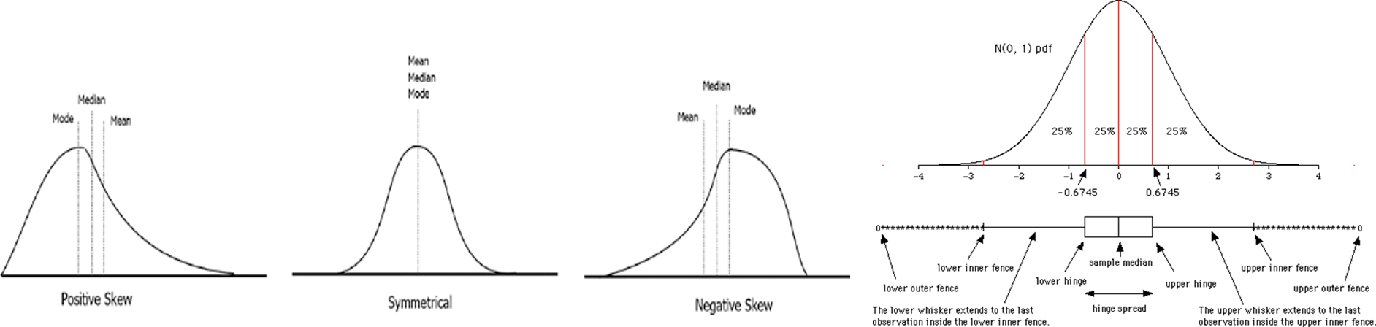
Defining the descriptive statistics
1. Measure of central tendency: mean, median, mode
Measures the “average” or the “middle” of your data. The most commonly used measures include:
•the mean: the average value. It’s sensitive to outliers.
•the median: the middle value. It’s a robust alternative to mean.
•and the mode: the most frequent value

Slide 17
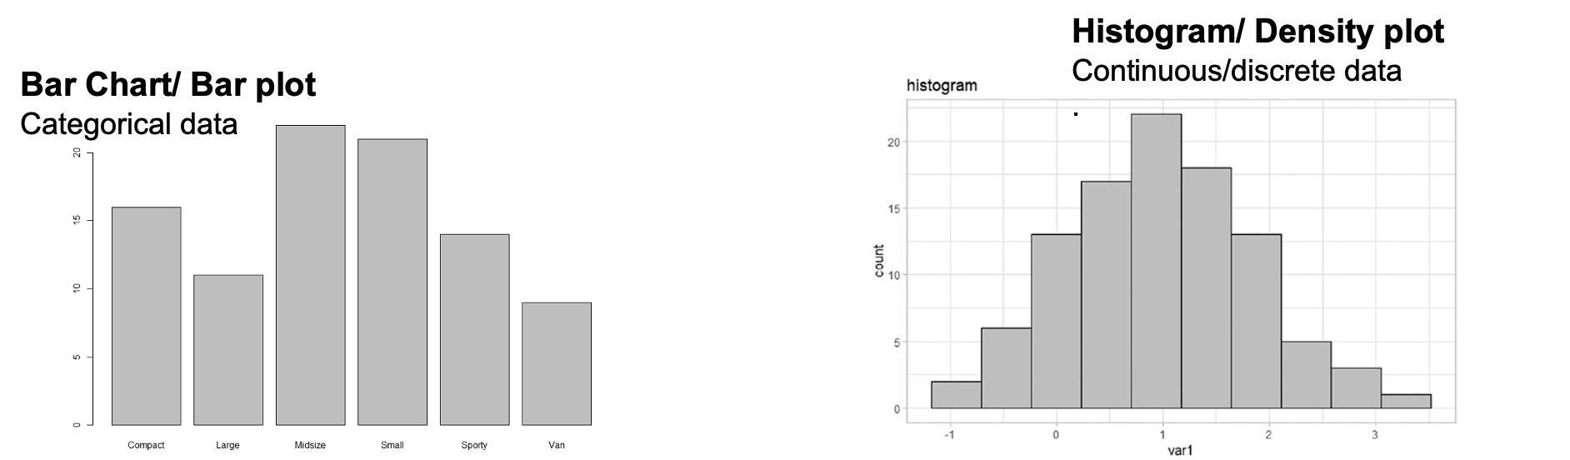
Defining the descriptive statistics
2. Measure of variability
Measures of variability gives how “spread out” the data are.
•Range: minimum & maximum
•Range corresponds to biggest value minus the smallest value. It gives you the full spread of the data.

Slide 18
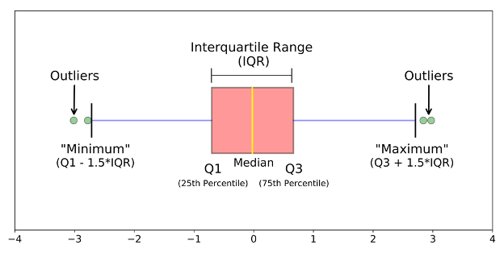
Defining the descriptive statistics
3. Interquartile Range (IQR)
Quartiles divide the data into 4 parts. IQR corresponds to the difference between the first and third quartiles - is sometimes used as a robust alternative to the standard deviation.

Slide 19
Purpose of each descriptive statistic
1. Range. It’s not often used because it’s very sensitive to outliers.
2. IQR. It’s pretty robust to outliers.
3. Variance. It’s completely uninterpretable because it doesn’t use the same units as the data. It’s almost never used
4. Standard deviation. This is the square root of the variance. It’s expressed in the same units as the data. The standard deviation is often used in the situation where the mean is the measure of central tendency.
5. Median. It’s a robust way to impute for missing data, for data with outliers. Used with continuous data that is not normally distributed.
6. Mode. Imputes for missing data that is categorical
7. Mean. Imputes for missing continuous data that is normally distributed

Slide 20
Testing for normal distribution
Rule of thumb:
Many of the statistical tests including correlation, regression, t-test, and analysis of variance (ANOVA) assume some certain characteristics about the data. They require the data to follow a normal distribution or Gaussian distribution. These tests are called parametric tests, because their validity depends on the distribution of the data.

Slide 21
Testing for normal distribution
So the distribution of data has to be testing using the following:
1. Visual inspection [normal plots (histogram), Q-Q plot (quantile-quantile plot)], boxplots)
2. Significance tests. Such as Shapiro-Wilk’s test (samples >3< 5000) and Kolmogorov-Smirnov (K-S) test (samples > 5000)
Data distribution also informs how missing data is handled

Slide 22
OUTLIER DETECTION
What are outliers?
Values in data which are unusual for a given context.
Inconsistencies in data, features not part of the flow of data.

Slide 23
OUTLIERS
Not always bad or an error
e.g height of players
life expectancy
If most students score between 50 and 80 in a test, but one student scores 0 and another 100, these maybe considered outliers.

Slide 24
Causes of Outliers
Understanding causes of outliers is essential before deciding how to handle them.
Errors- sampling errors, measurement errors, data processing errors

Slide 25
Causes of outliers
Sampling errors (data collection)?
Occurs when the sample does not accurately represent the population due to randomness or bias in selection. Poor sampling method, small sample size etc..
For example:
A survey on household income conducted only in wealthy neighborhoods may include unusually high-income values (outliers), not representing the general population.

Slide 26
Causes of outliers
Data Processing errors (Data handling)?
Occur due to mistakes in entering, recording, or handling data.
causes
Typos and entry mistakes entering 95.0 as 950

Slide 27
Causes of outliers
Unit conversion errors. Recording temperature in Fahrenheit instead of Celsius
Software bugs- incorrect rounding or calculations in a program.
Problems merging data sets from different sources.

Slide 28
Causes of outliers
Measurement errors ?
occurs when the instrument or method used to collect data is faulty or inaccurate.
causes
Instrument Errors – A scale that is not calibrated correctly.

Slide 29
Causes of outliers
Observer Errors – A researcher misreading a measuring device.
Environmental factors –
Suppose a thermometer records 40°C instead of 30°C due to sensor malfunction or weighing scale shows 120kg instead of 100kg

Slide 30
Causes of outliers
Variability– Genuine extreme values in data.
Maybe due to natural differences
For example
Most players range between 1.80m - 2.10m, but Tacko Fall (2.26m) is an outlier.
A marathon runner completing a race in record time.

Slide 31
Causes of outliers
Anomalies
Such as fraud, rare diseases,
For example a bank analyzing credit transactions
A customer usually spends $50-$300 per transaction.
Suddenly, a charge of $20,000 appears in a different country.

Slide 32
Types of outliers
Univariate Outliers
Extreme values in a single variable
Example
In a dataset of peoples height (in cm), if most values range between 150 and 190, but one entry is 300 cm, it may be an outlier

Slide 33
Types of outliers
Multivariate Outliers
These are unusual combinations of values across multiple variables.
Example
A person who is 120 cm tall but weighs 150 kg might be an outlier, even though neither height nor weight alone is extreme

Slide 34
Outliers
EXPERIENCE
2
5
10 | Median =14
12
60
24 | upper limit =30
16
9
18
23
AGE | EXPERIENCE
22 | 2
29 | 5
35 | 10
36 | 12
23 | (14,30)
49 | 24
42 | 16
34 | 9
40 | 18
55 | 23

Slide 35
Types of outliers
Contextual Outliers
Global – extreme across the entire dataset
Contextual – depend on the specific situation
Example
A temperature reading of 35°C in summer is normal, but in winter might be an outlier.

Slide 36
Identifying Outliers
Visualization Techniques
Box plots- show quartiles and highlight extreme values
Histogram

Slide 37

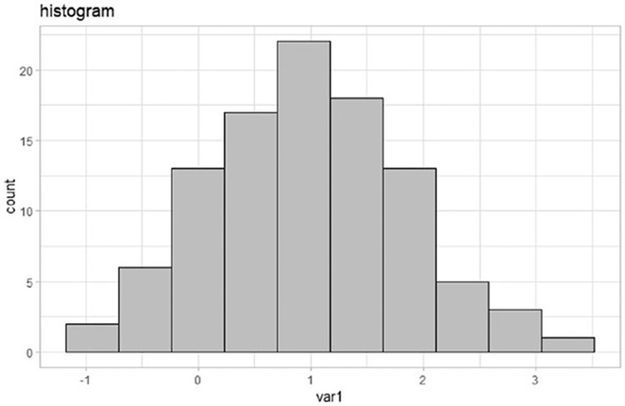
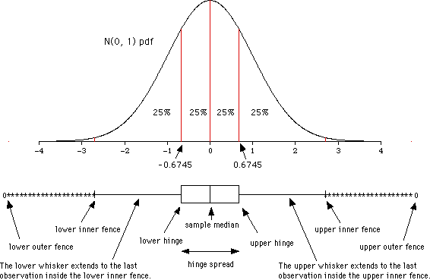

Central tendencies/normal distribution
The normal distribution = Gaussian distribution
.If normally distributed, use a parametric statistical
approach

Slide 38
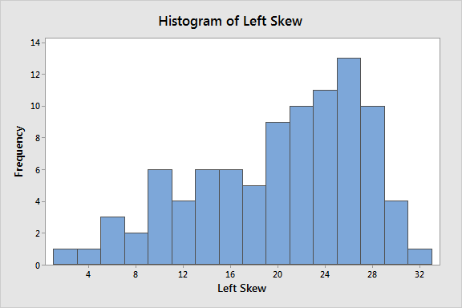
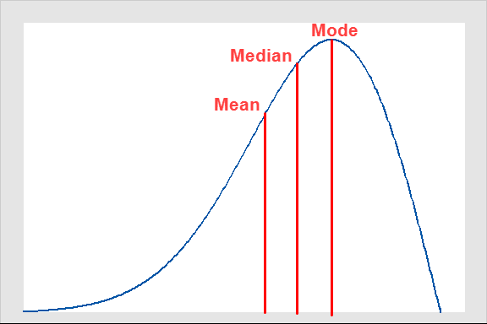
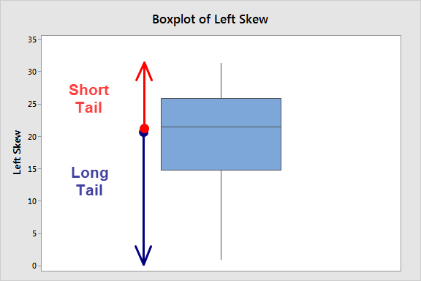
Negatively/Left skewed
Left skewed distributions occur when the long tail is on the left side of the distribution
A box plot also displays this
As opposed to having the “bell- curve” of normal distribution;
The mean is less than the median
The mean underestimates the most common values in a negatively skewed distribution
.

Slide 39

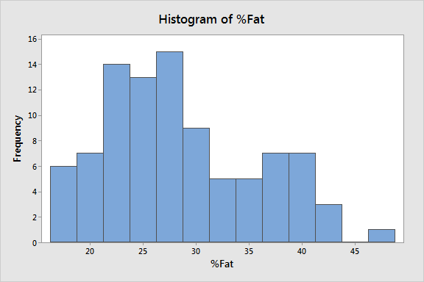
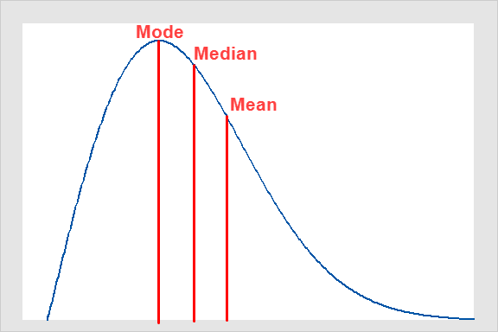
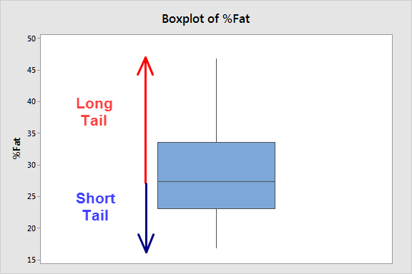
Positively/Right skewed
Right skewed distributions occur when the long tail is on the right side of the distribution
A box plot also displays this
As opposed to having the “bell- curve” of normal distribution;
The mean is greater than the median
The mean overestimates the most common values in a positively skewed distribution
.

Slide 40
Identifying Outliers
Visualization Techniques
Scatter plots-
Histogram

Slide 41
Identifying Outliers
Statistical Methods
Standard Deviation -Z score
Sensitive to outliers

Slide 42
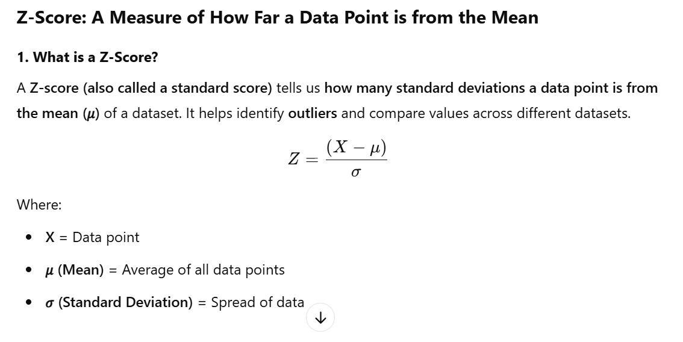
Identifying Outliers

Slide 43
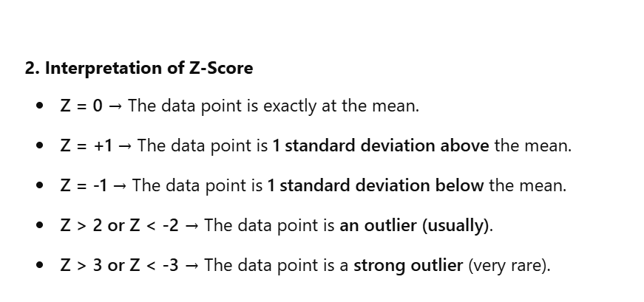
Identifying Outliers

Slide 44
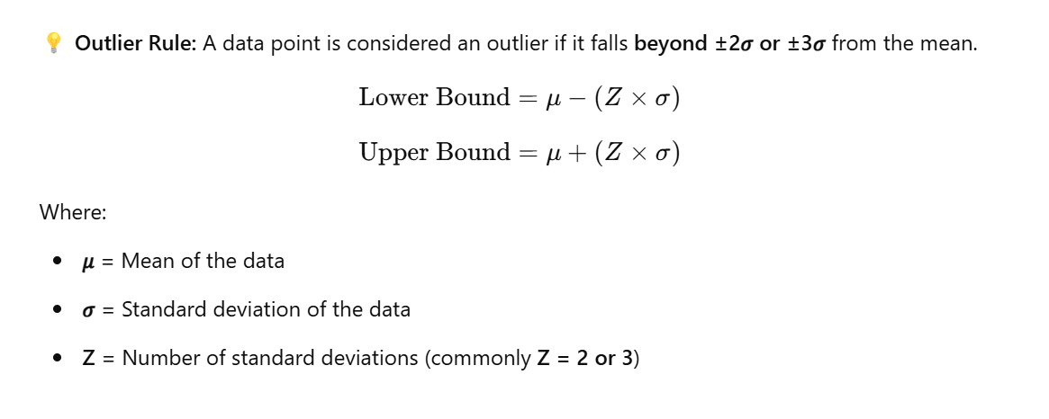
Identifying Outliers

Slide 45
Identifying Outliers
Inter quartile range (IQR) Method
Find Q1 (25th percentile) and Q3 (75th percentile).
Compute IQR:
IQR= Q3−Q1
Any value below Q1 - 1.5 × IQR or above Q3 + 1.5 × IQR is considered an outlier.

Slide 46
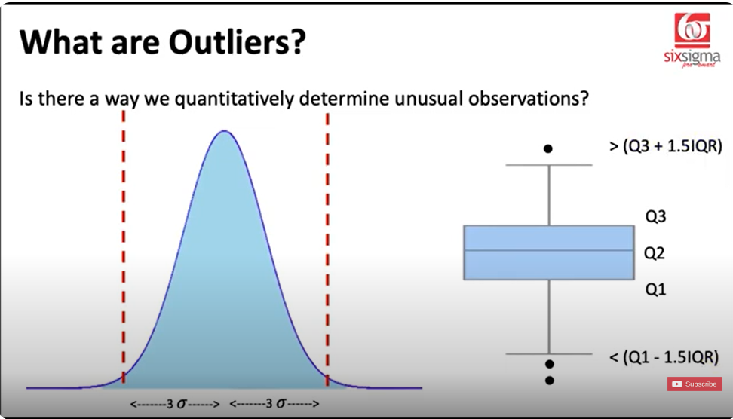
Identifying Outliers

Slide 47
Identifying Outliers
Interquartile Range (IQR)
Quartiles divide the data into 4 parts. IQR corresponds to the difference between the first and third quartiles - is sometimes used as a robust alternative to the standard deviation.

Slide 48
Identifying Outliers
Machine learning- Based Methods
Isolation Forests:
Detect anomalies by isolating rare data points in a tree-based structure.
Clustering:
Groups dense data points together and identifies sparse ones as outliers.

Slide 49
Handling Outliers
Remove outliers
If they are due to errors.
Example:
If a height value of 900 cm appears, it is likely a typo and can be deleted.
Caution: Removing outliers without justification may lead to loss of valuable information.

Slide 50
Handling Outliers
Remove outliers
If you have no more than 30% missing.
Impute with zeros (if certain there was no information)

Slide 51
Handling Outliers
Transform the data
Applying log or square root transformations can reduce the effect of extreme values.
Example: Instead of using raw income data (which has extreme values), we can apply a logarithmic scale.

Slide 52
Handling Outliers
Impute Outliers
Replace extreme values with
Mean if numeric variables are normally distributed.
Median if numeric variables are skewed
Mode if variables are categorical (text,string)

Slide 53
Handling Outliers
Impute Outliers
Replace extreme values with
Mode if variables are categorical (text, string)
Predicted values of IQR method

Slide 54
Handling Outliers
Use robust models
Some algorithms, like decision trees and random forests, handle outliers better than linear regression.
Robust statistical methods like the median absolute deviation (MAD) can help deal with extreme values.

Slide 55
Practical considerations
Understand the domain
In financial data – could indicate fraud rather than errors.
In scientific research could represent a ground breaking discovery.

Slide 56
Practical considerations
Balance cleaning with retaining information
Removing outliers without analysis can lead to incorrect conclusions.
Some outliers provide valuable insights.

Slide 57
Practical considerations
Use multiple detection techniques
Combining statistical, visualization and machine learning methods leads to better accuracy in identifying outliers.

Slide 58
Practical considerations
Understand the domain
In financial data – could indicate fraud rather than errors.
In scientific research could represent a ground breaking discovery.
Balance cleaning with retaining information
Removing outliers without analysis can lead to incorrect conclusions
Some outliers provide valuable insights

Slide 59
Practical considerations
Outliers are crucial in data mining and wrangling because they can be errors or valuable insights (anomalies worth investigating, could be new discoveries). Knowing how to detect and handle them properly improves data quality and model performance.

Slide 60
Practicum using python
1. Import the provided datasets in to visual studio (“Cassava_Yield_Data.xlsx” and “Bike_Sales.xlsx”)
2. Explore the datasets by identifying the data type of each variable.
3. Which variables are observations and which are samples?
4. Which variables are populations? (This will be guided by the questions you pose)
5. Transform both datasets to handle missing data.
6. Save the transformed datasets as .csv files with your last name.
7. Using the above saved datasets, describe the central tendency of two continuous variables.
8. Generate graphs to show the variability on one continuous variable and one categorical variable.

Slide 61
Outliers
EXPERIENCE
2
5
10 | Median =14
12
60
24 | upper limit =30
16
9
18
23
AGE | EXPERIENCE
22 to 55 | 2 to 30

Slide 62
Outliers
EXPERIENCE
2
5
10 | Median =14
12
60
24 | upper limit =30
16
9
18
23
AGE | EXPERIENCE
22 | 2
29 | 5
35 | 10
36 | 12
23 | (14,30)
49 | 24
42 | 16
34 | 9
40 | 18
55 | 23

